Slide 1
Image detection Methods
R-CNN, SPPnet,
Fast R-CNN, and Faster R-CNN

Slide 2
R-CNN

Slide 3
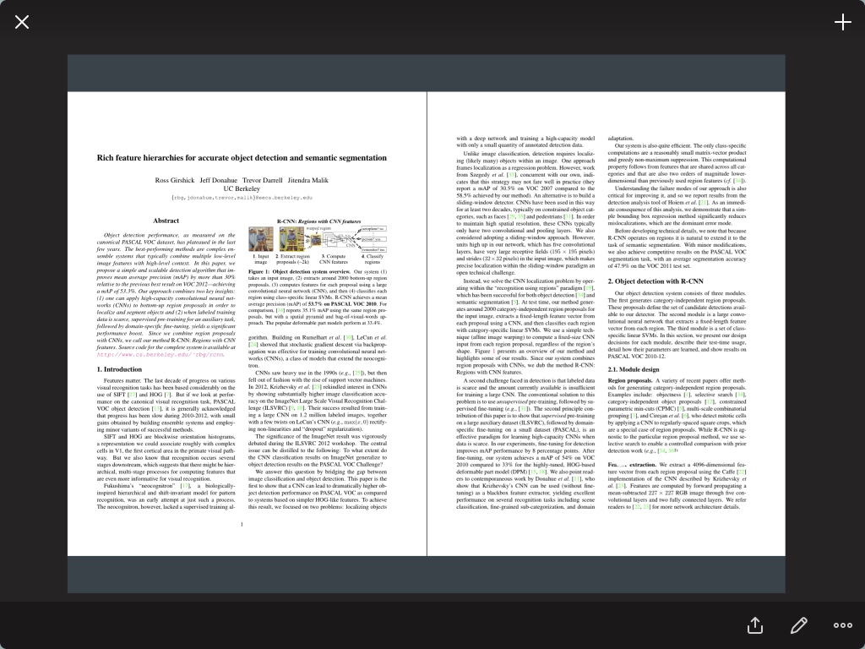

Slide 4
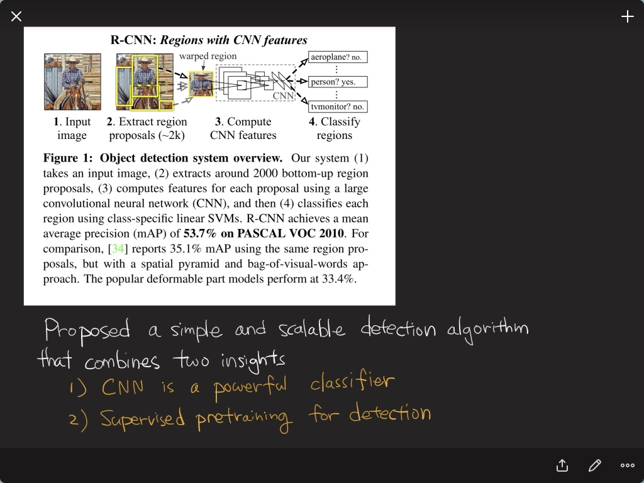

Slide 5
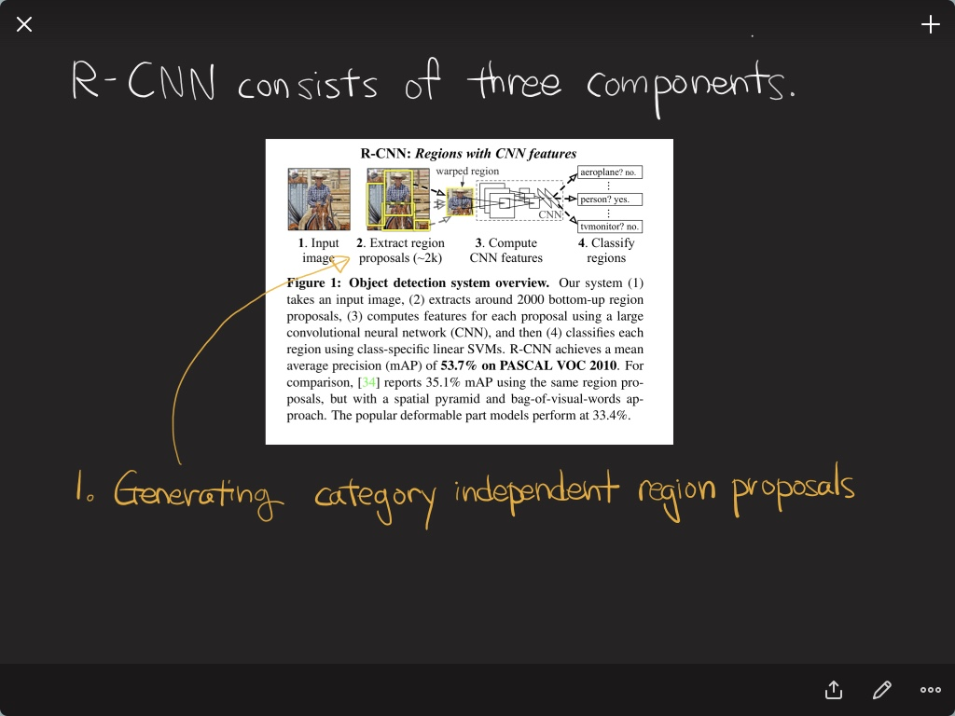

Slide 6
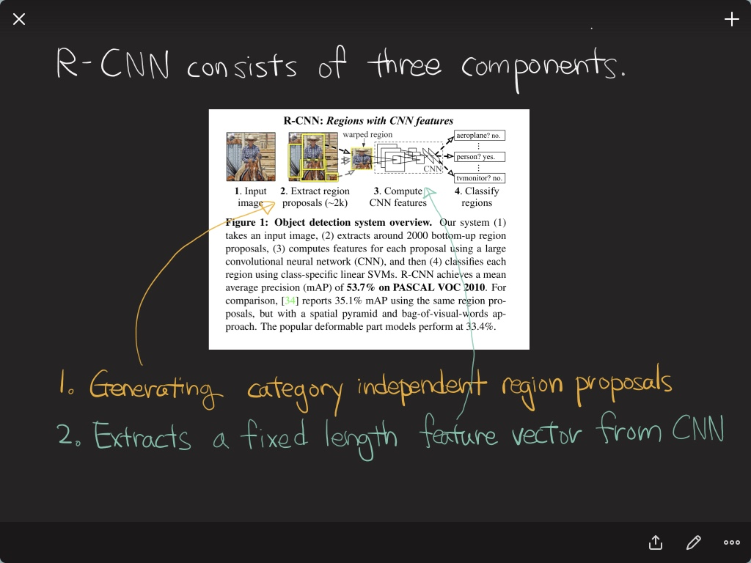

Slide 7
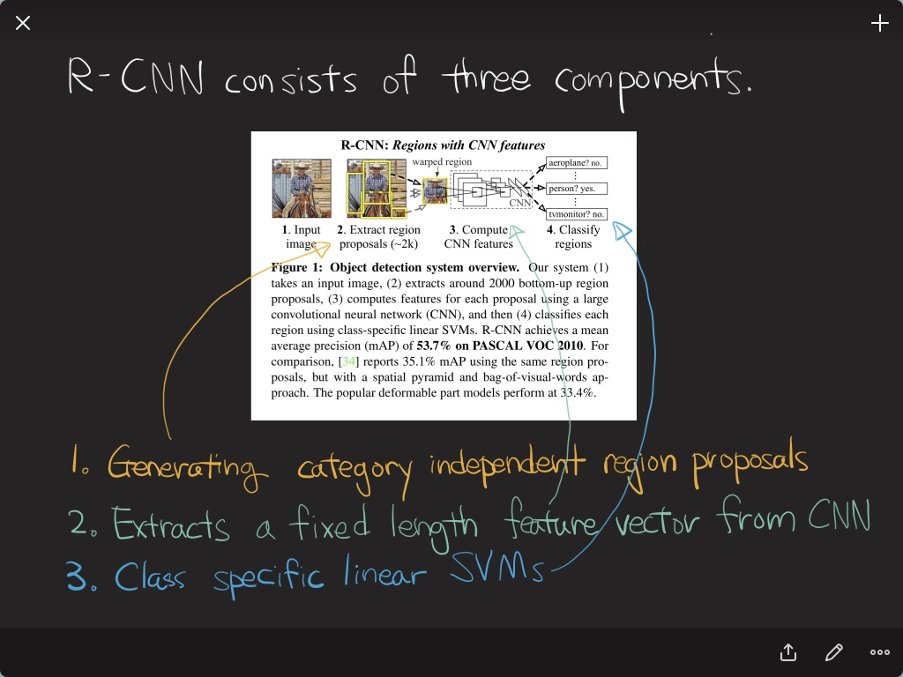

Slide 8
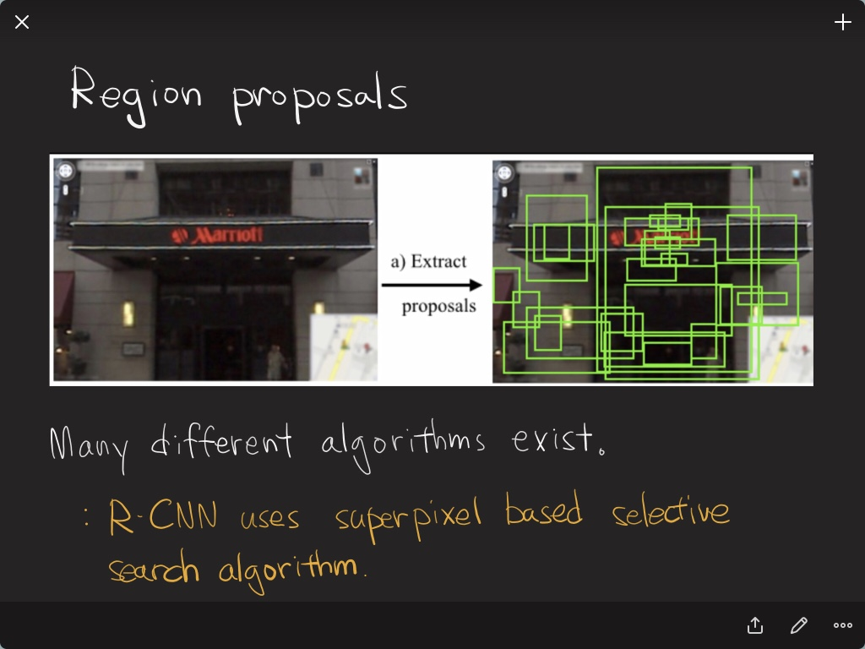

Slide 9
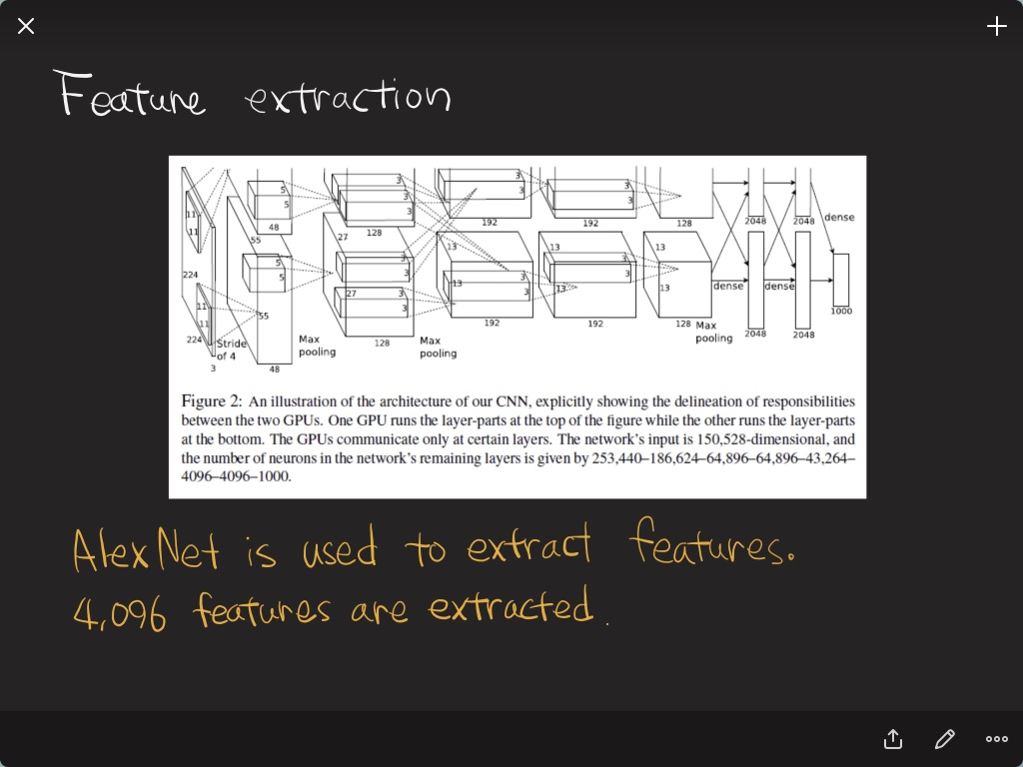

Slide 10
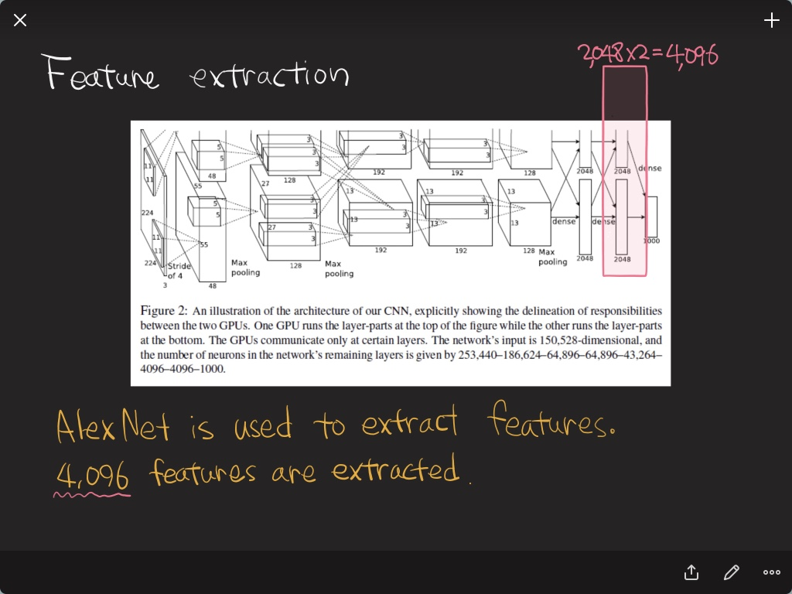

Slide 11
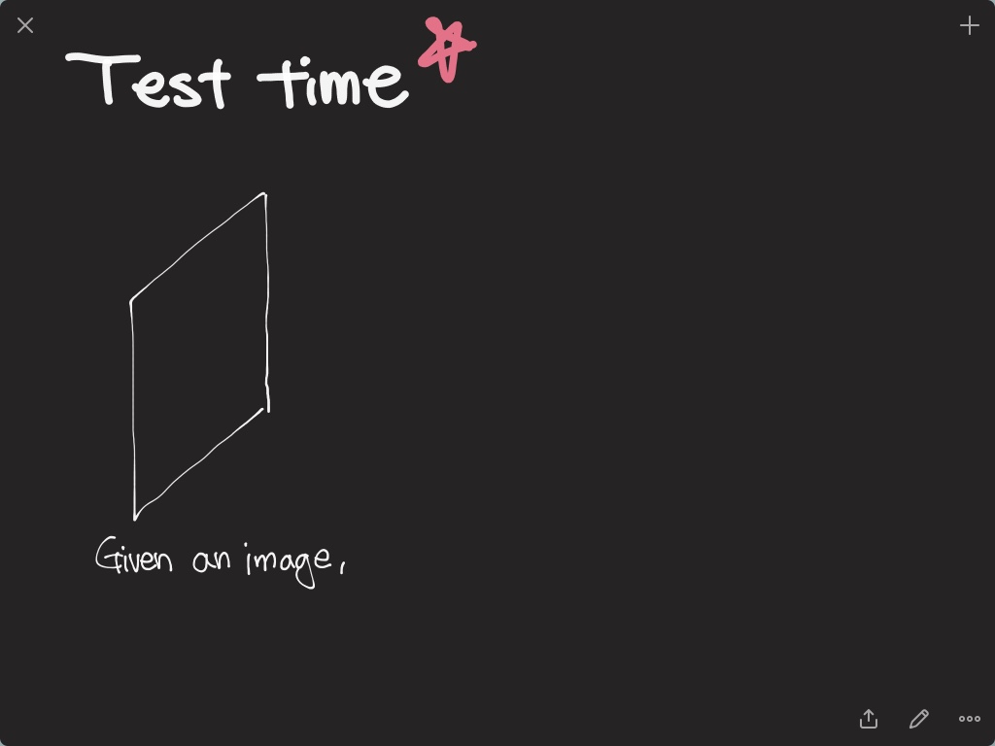

Slide 12
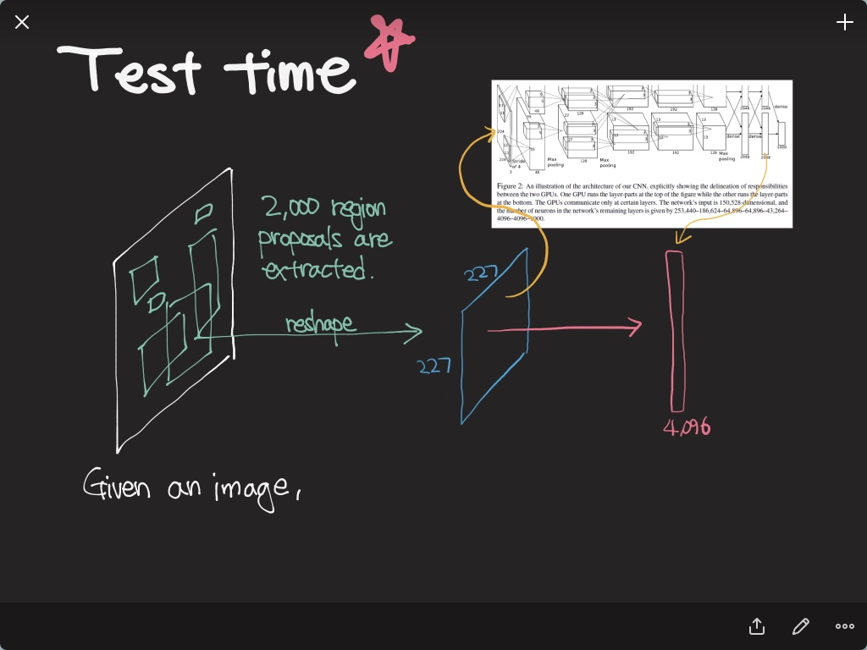

Slide 13
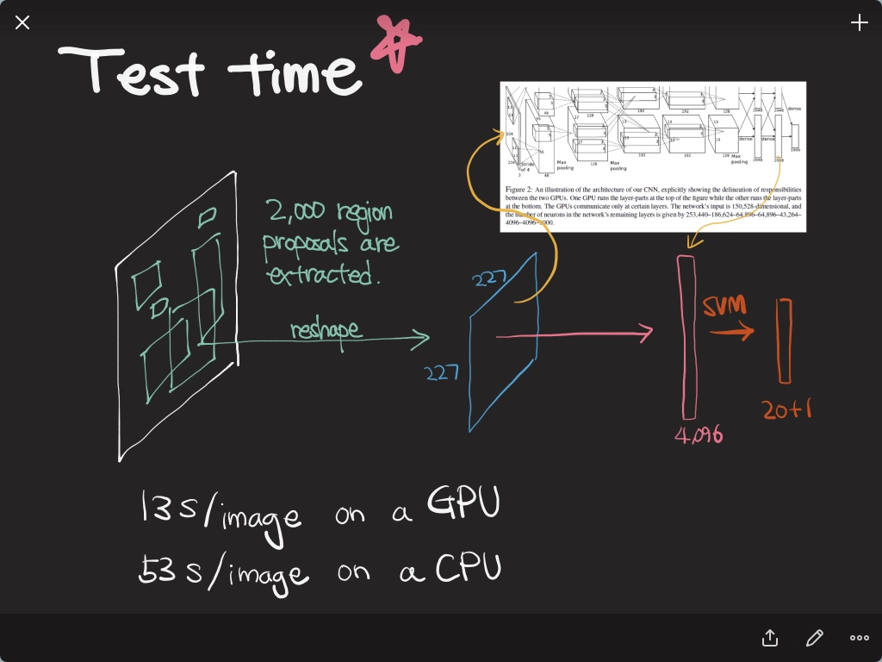

Slide 14
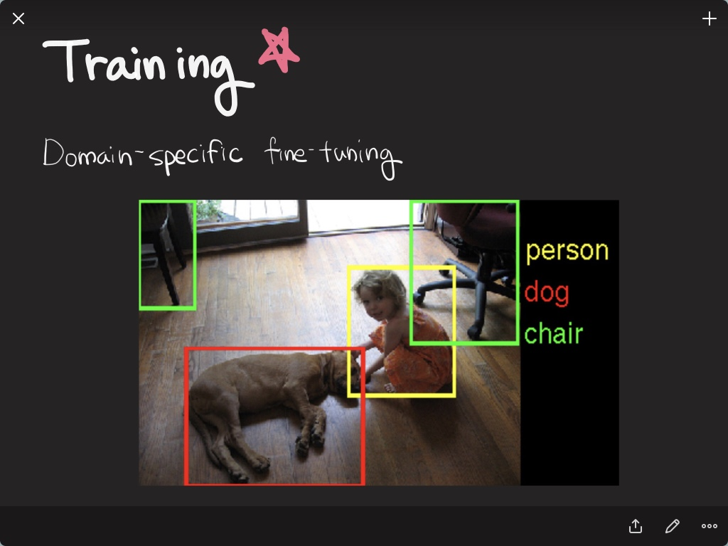

Slide 15
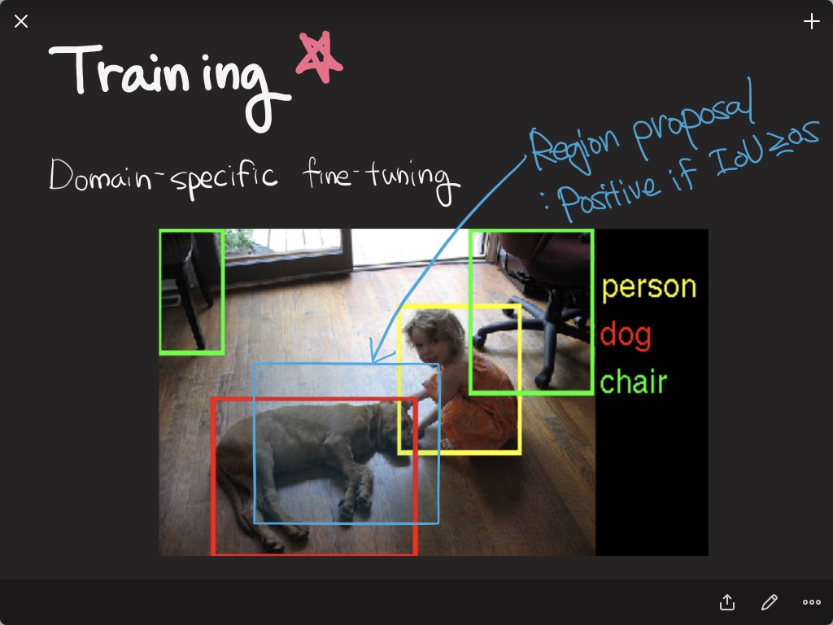

Slide 16
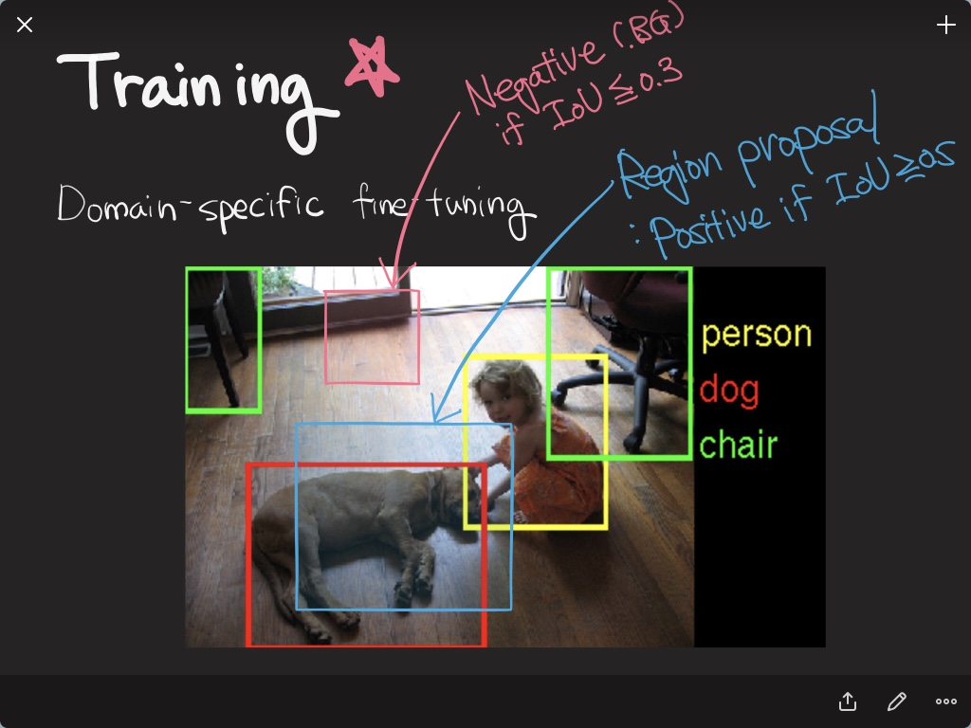

Slide 17
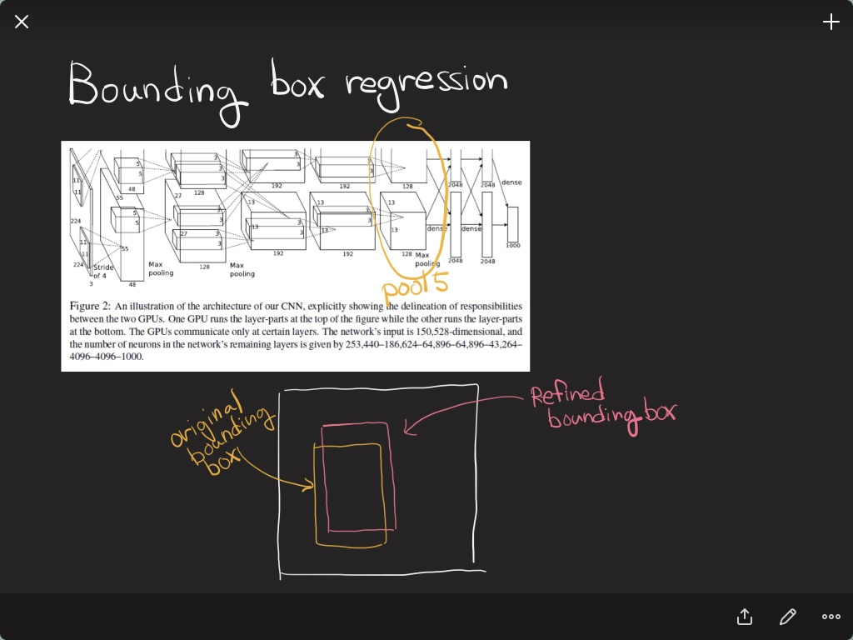

Slide 18
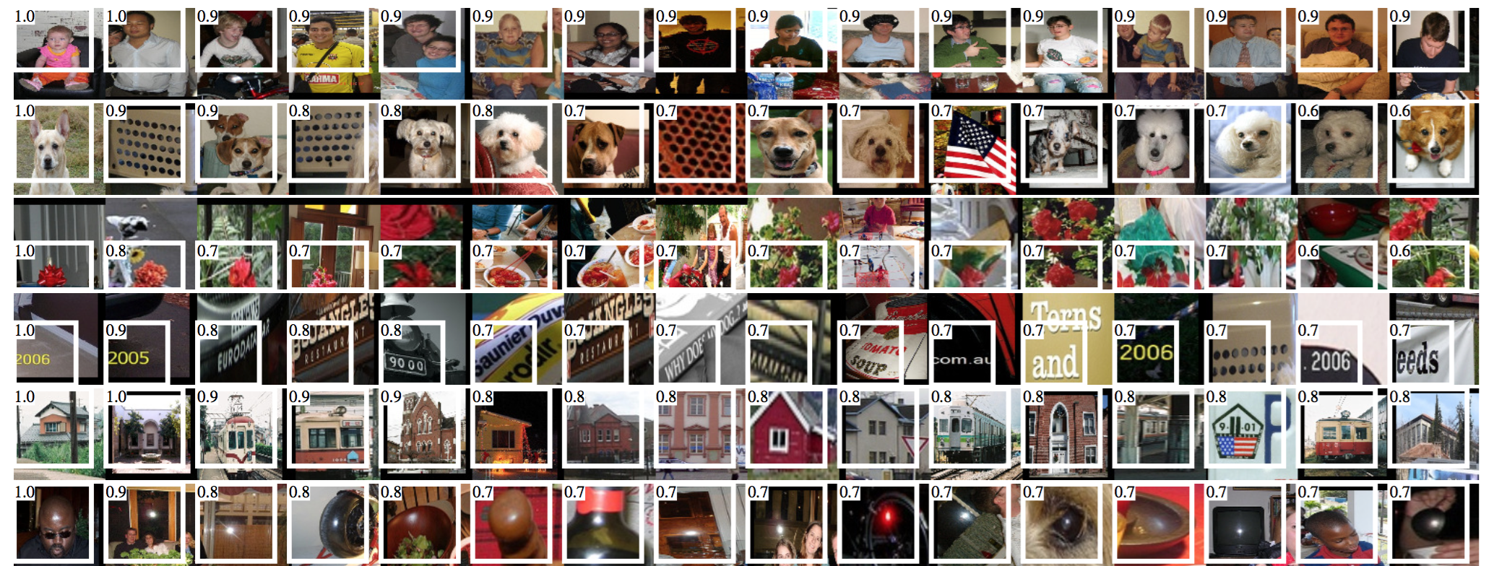
Results

Slide 19
SPPnet

Slide 20
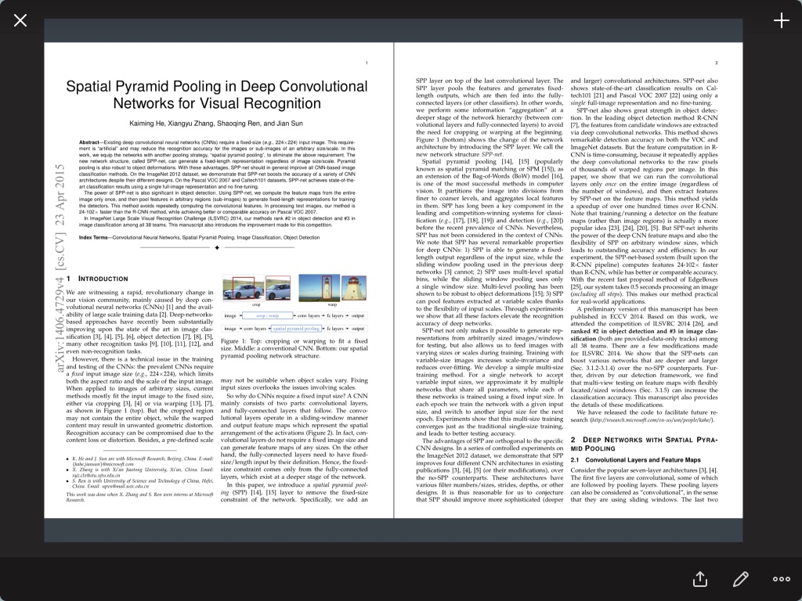

Slide 21
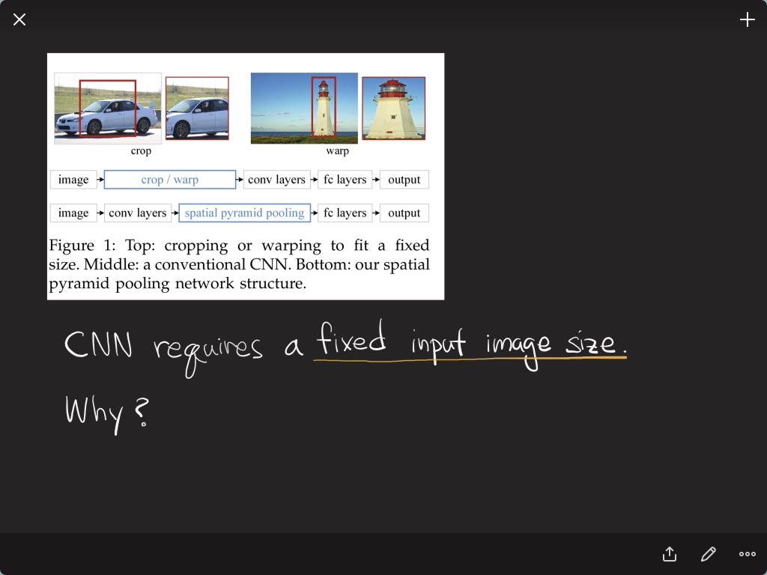

Slide 22
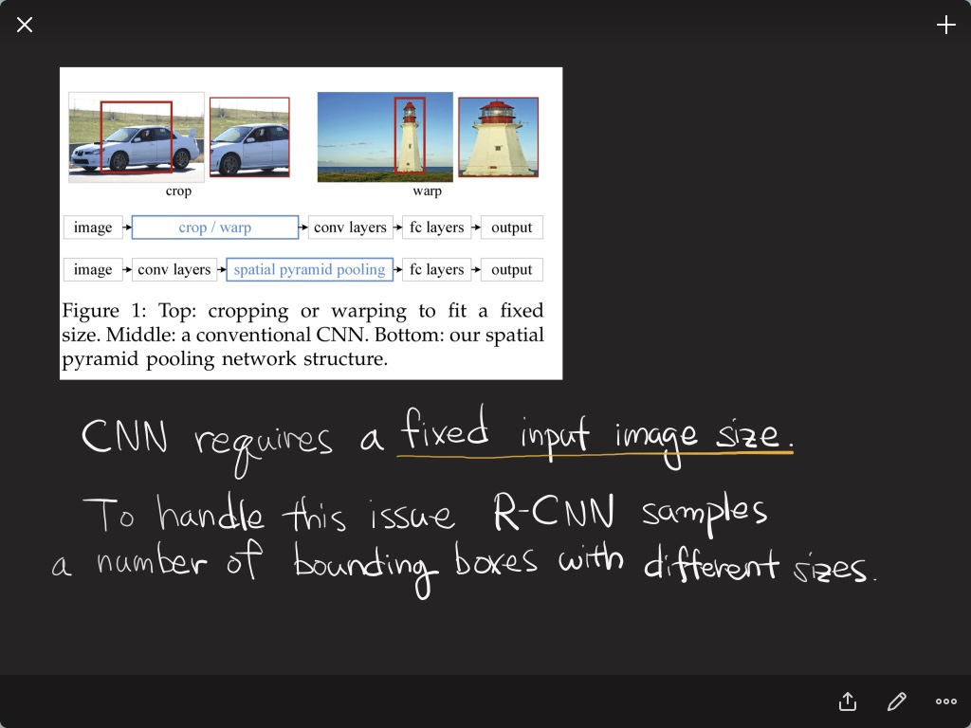

Slide 23
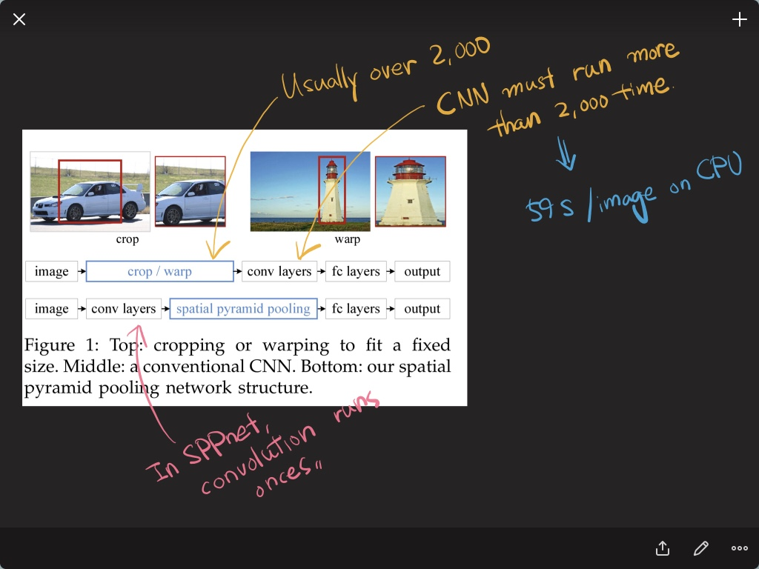

Slide 26
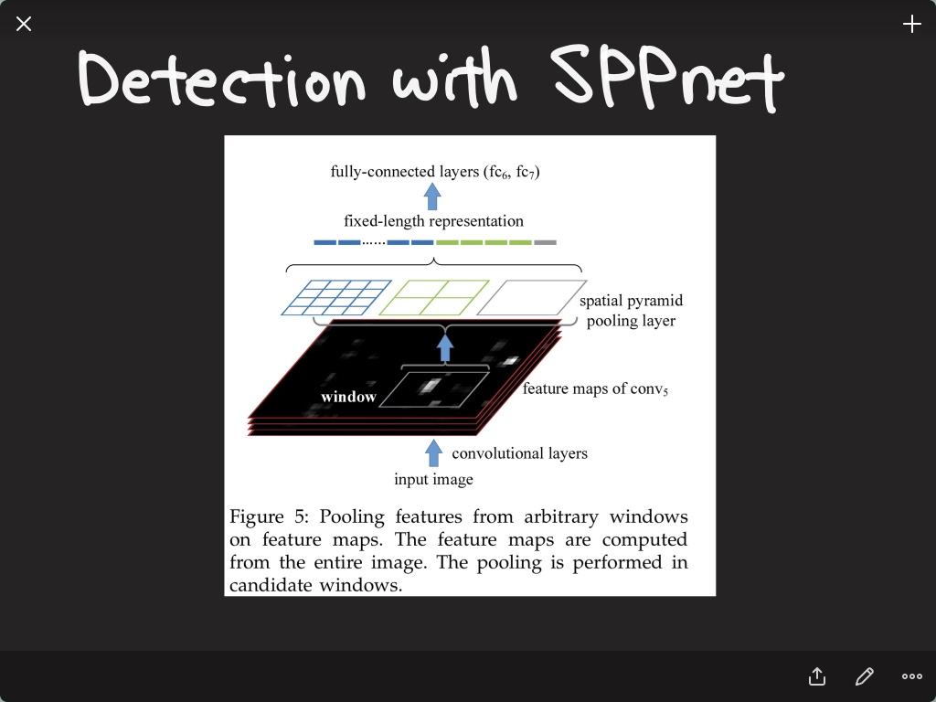

Slide 27
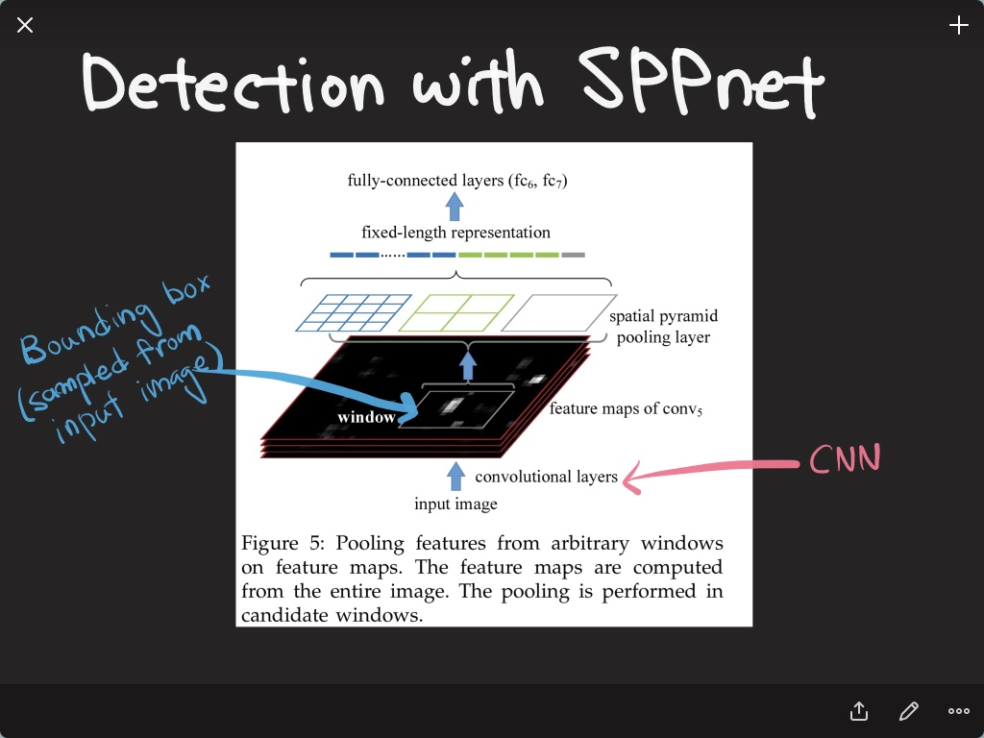

Slide 28
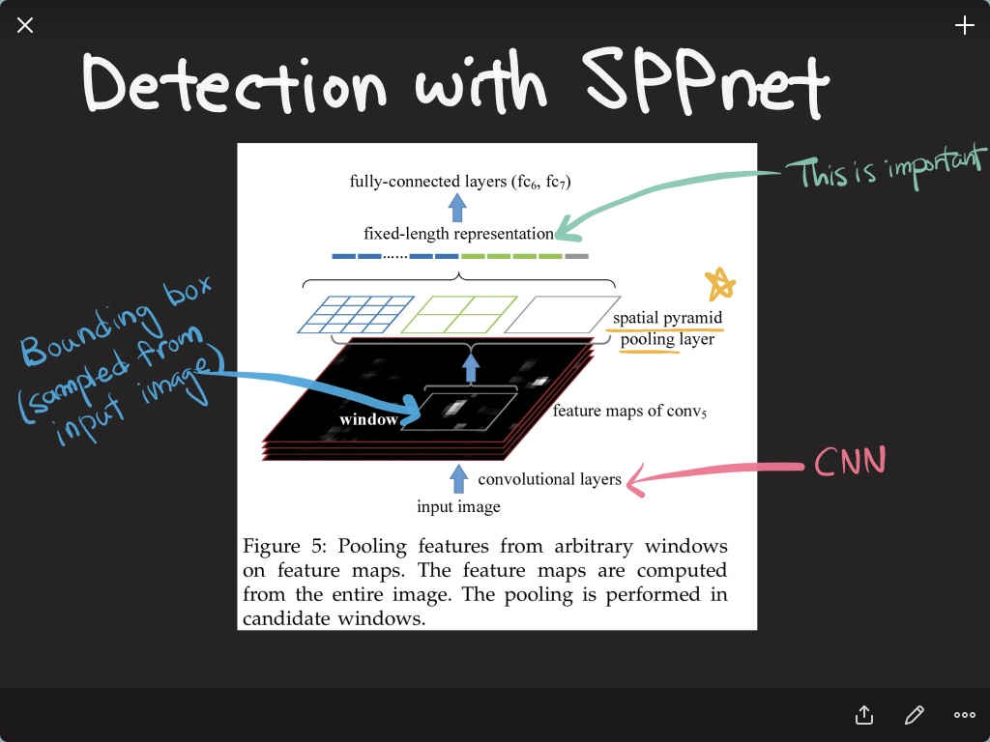

Slide 29
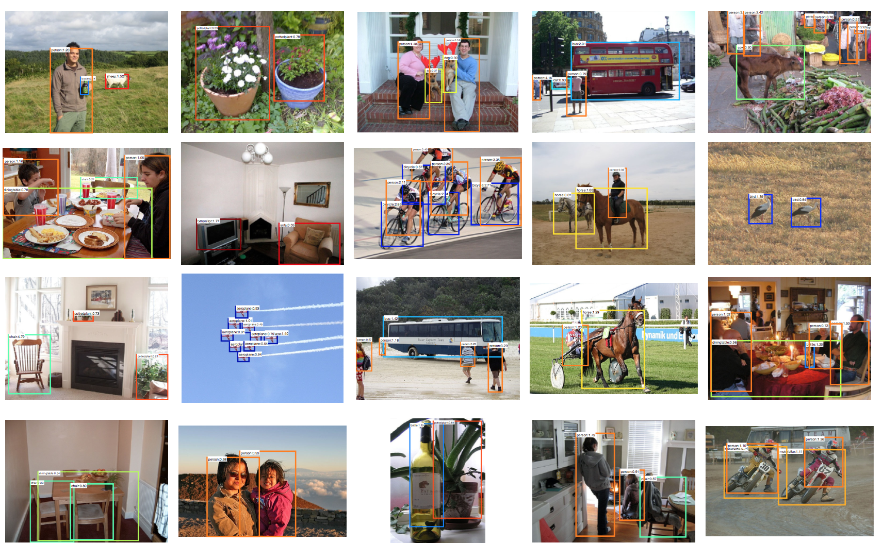
Results

Slide 30
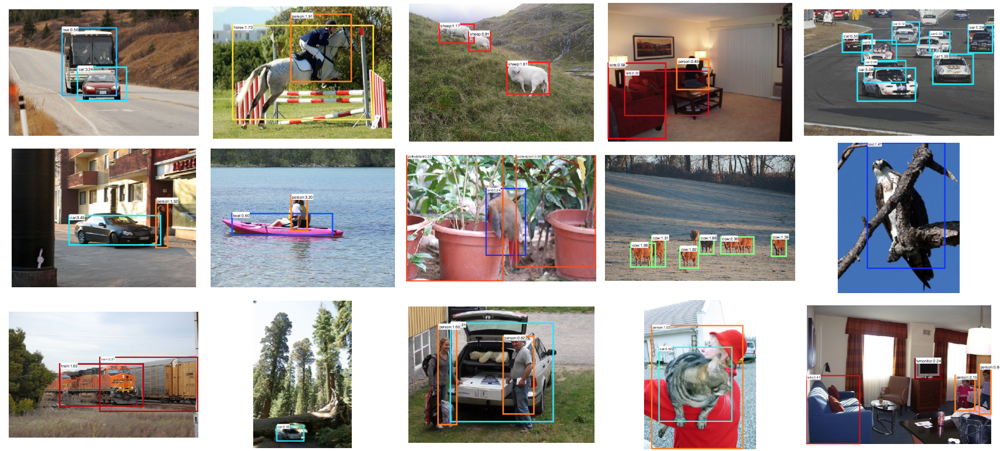
Results

Slide 31
Fast R-CNN

Slide 32
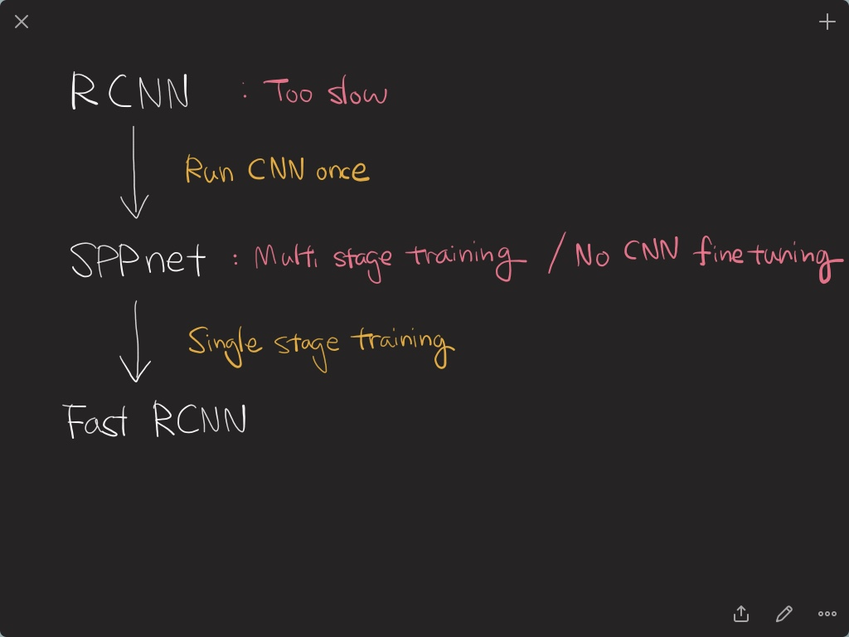

Slide 33
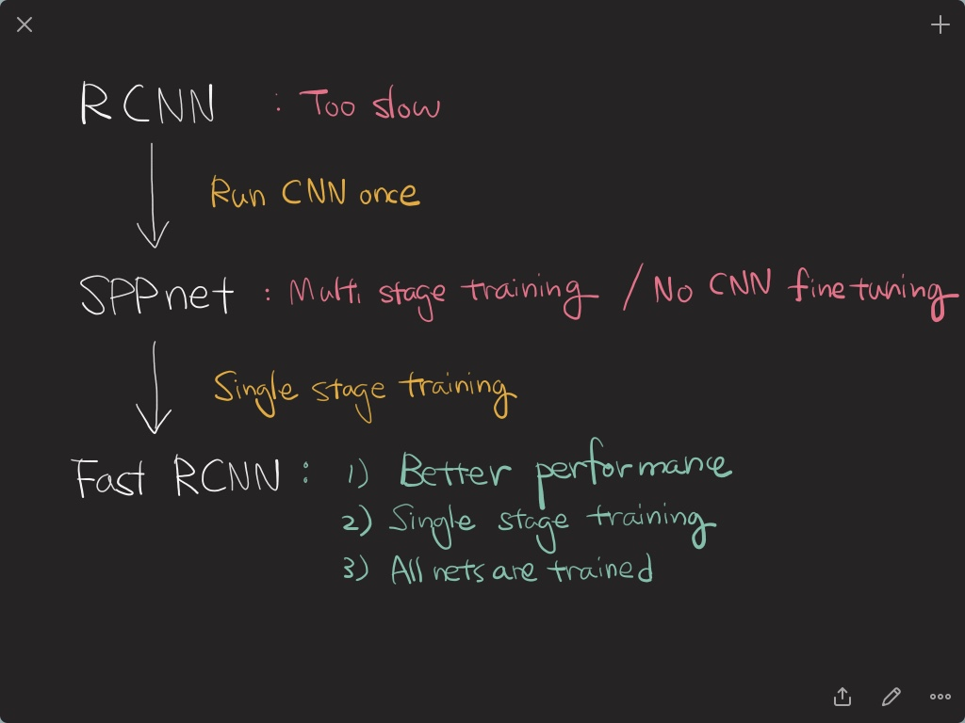

Slide 34
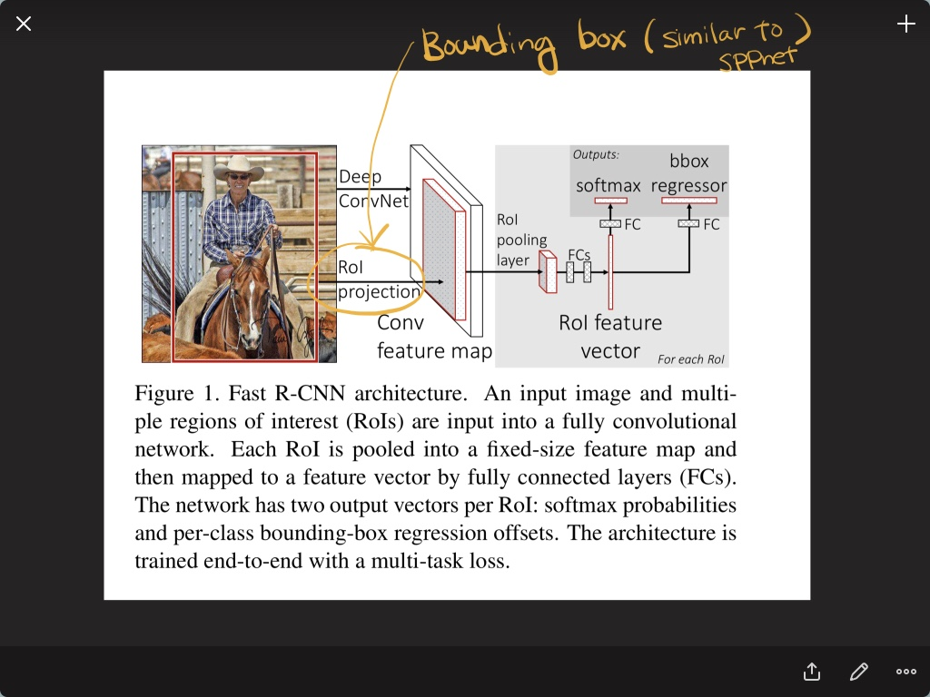

Slide 35
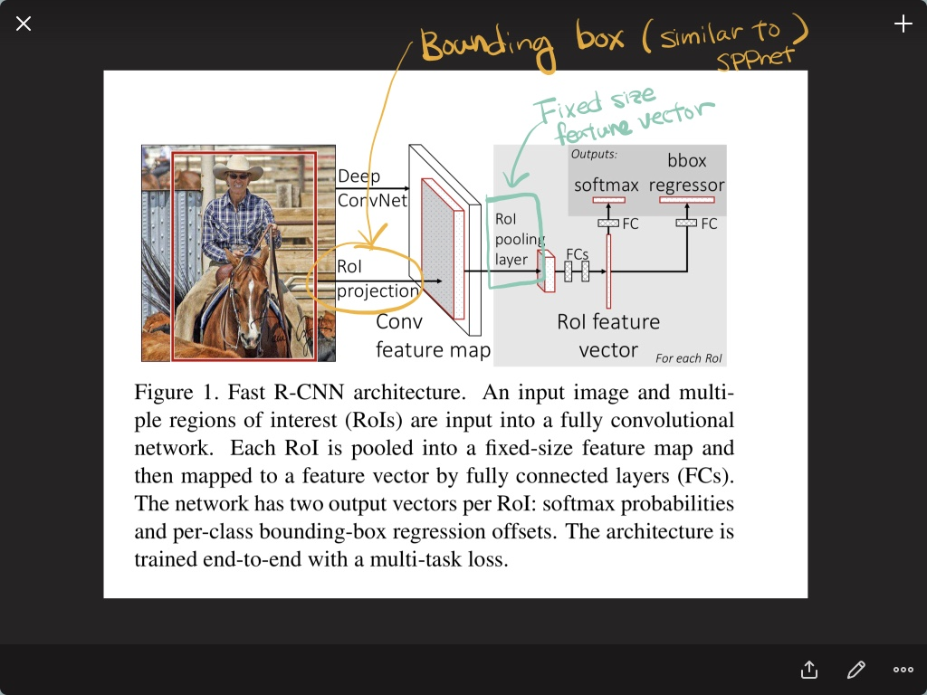

Slide 36
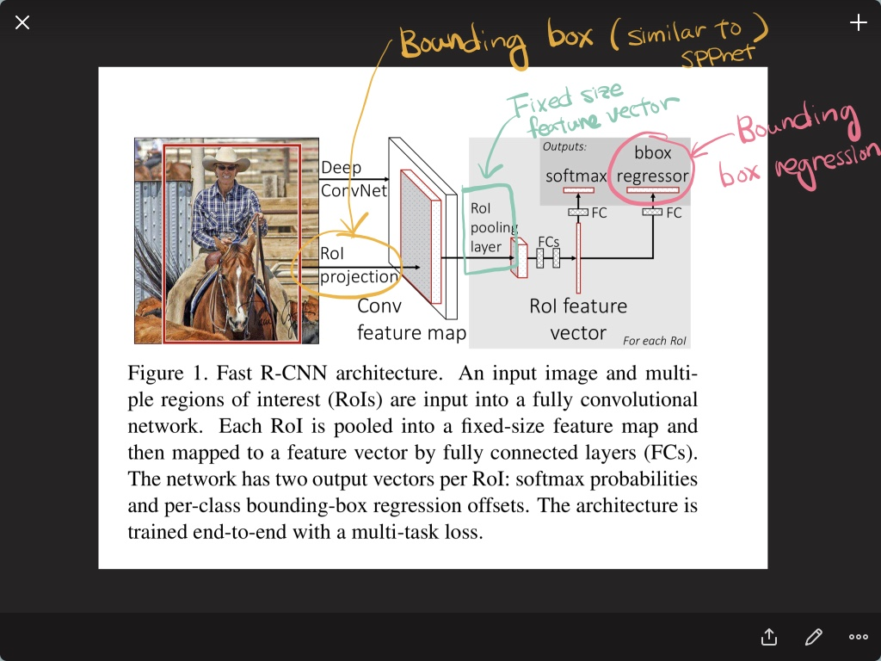

Slide 37
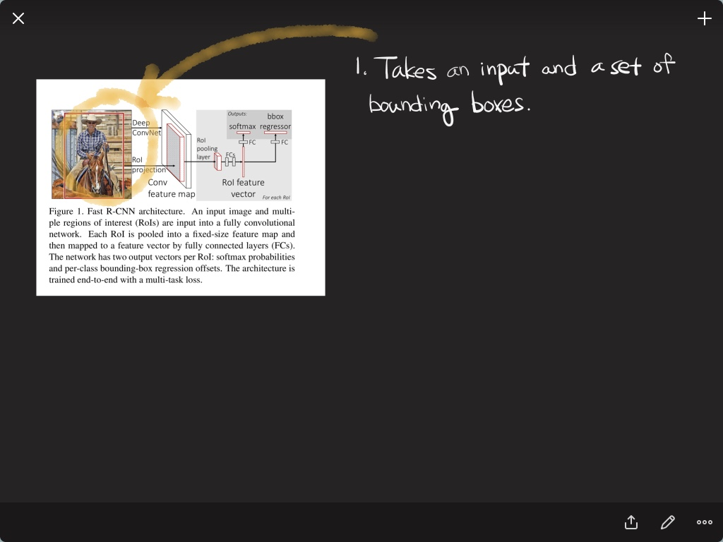

Slide 38
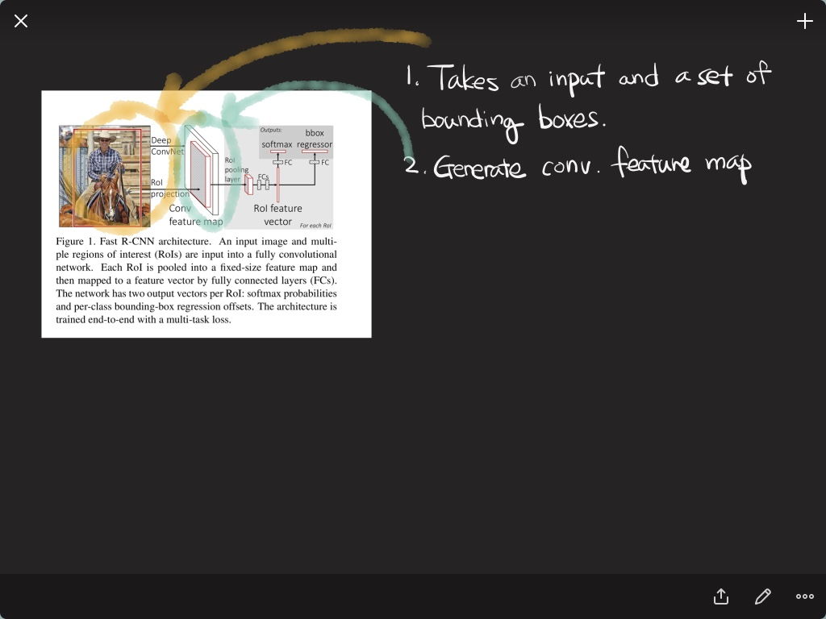

Slide 39
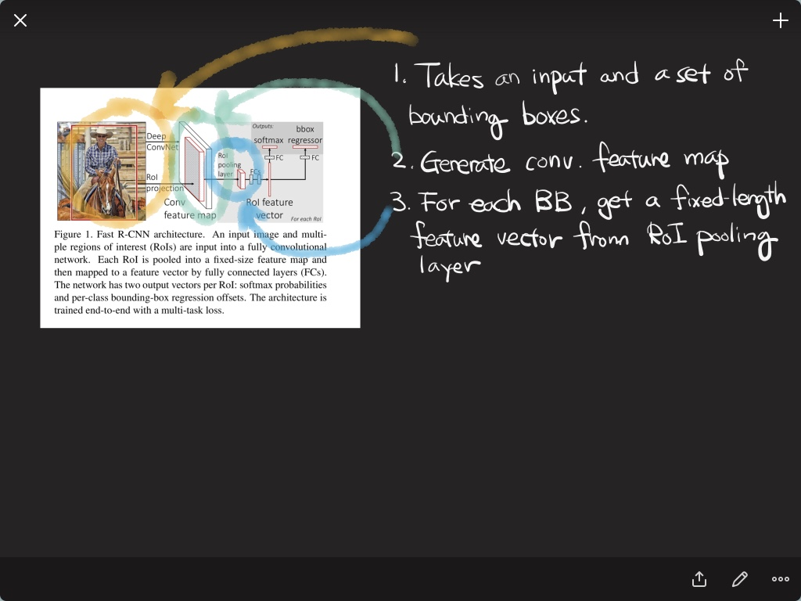

Slide 40
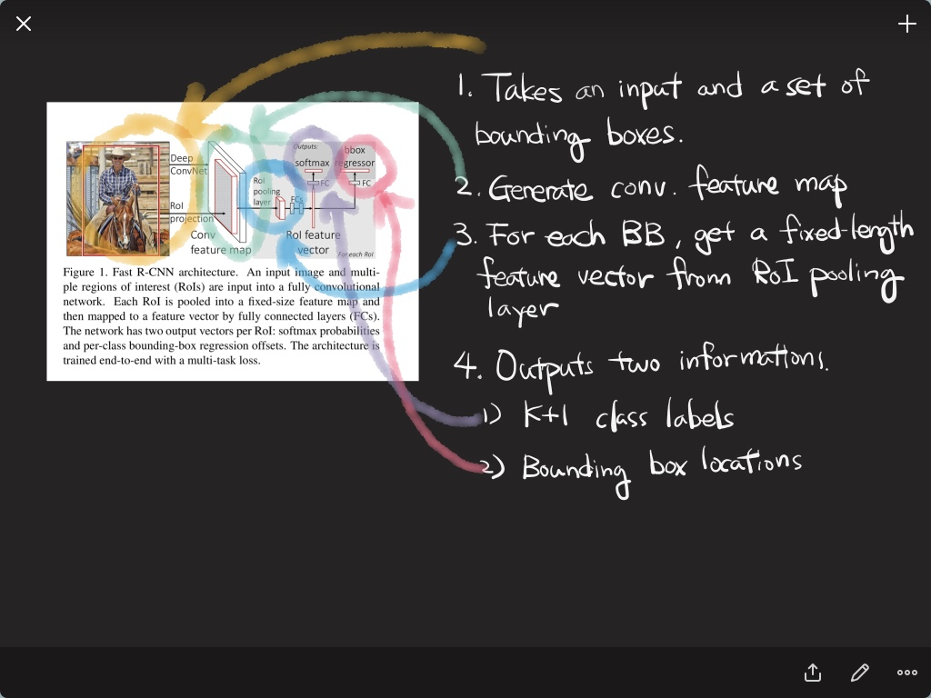

Slide 41
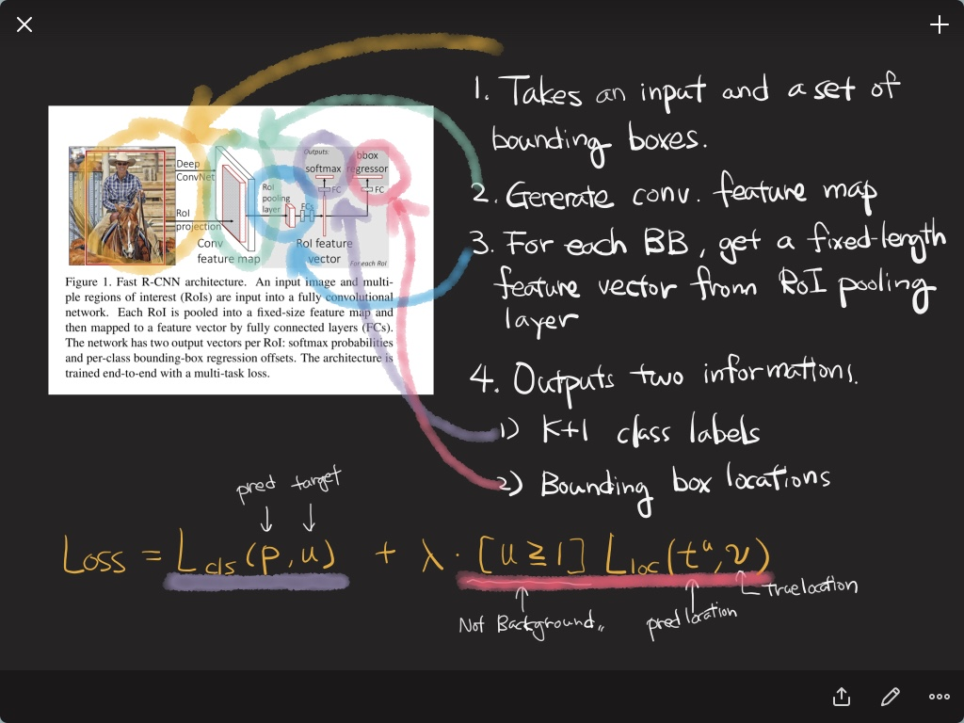

Slide 42
Faster R-CNN

Slide 43
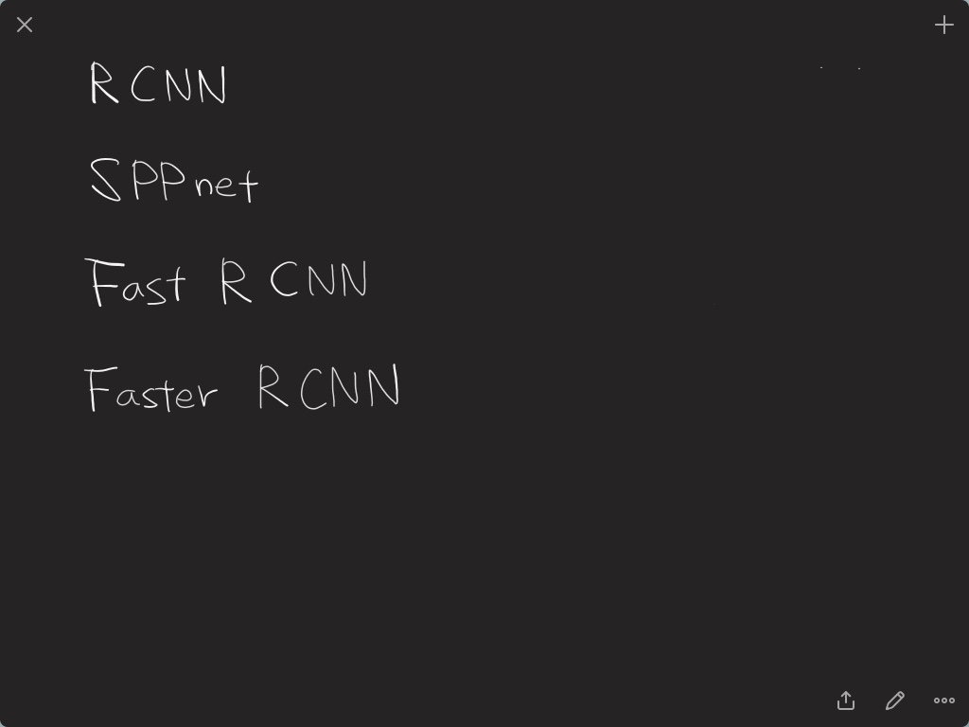

Slide 44
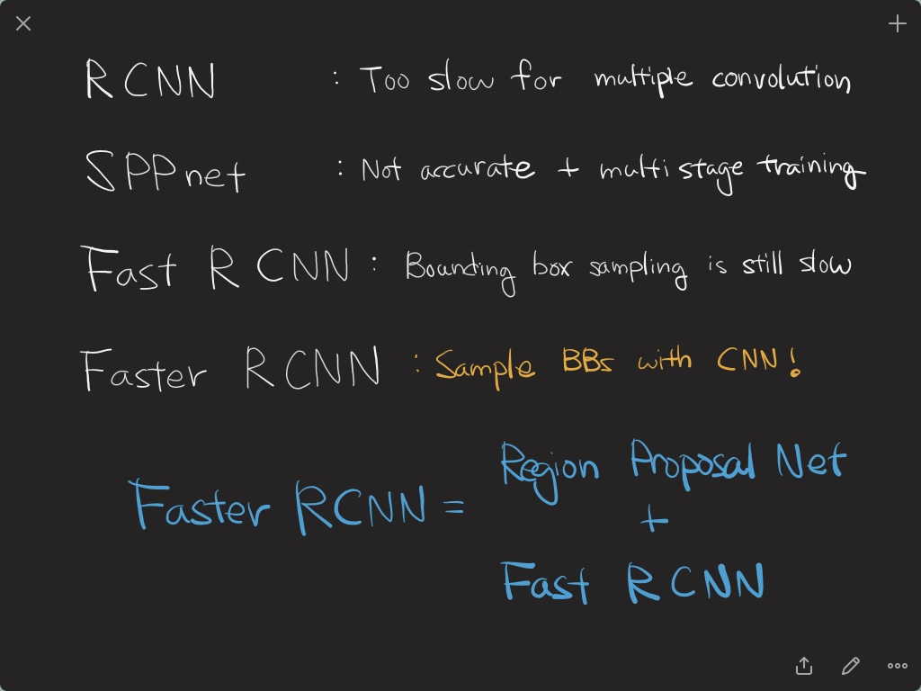

Slide 45
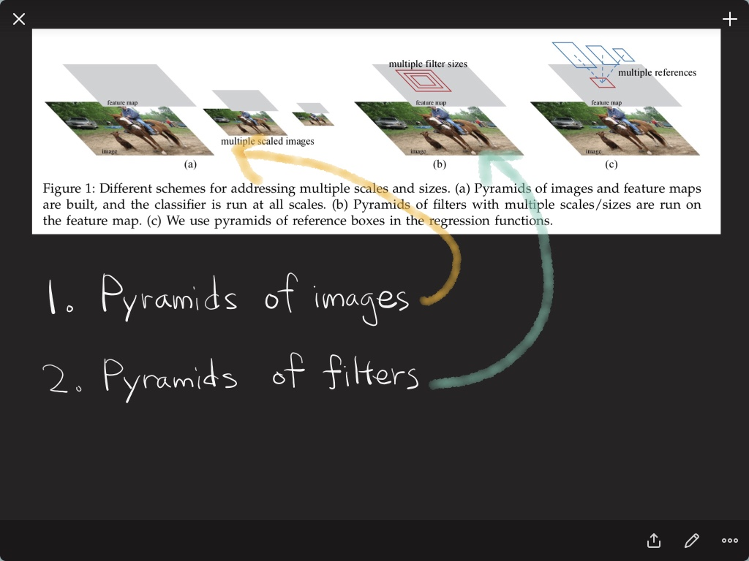

Slide 46
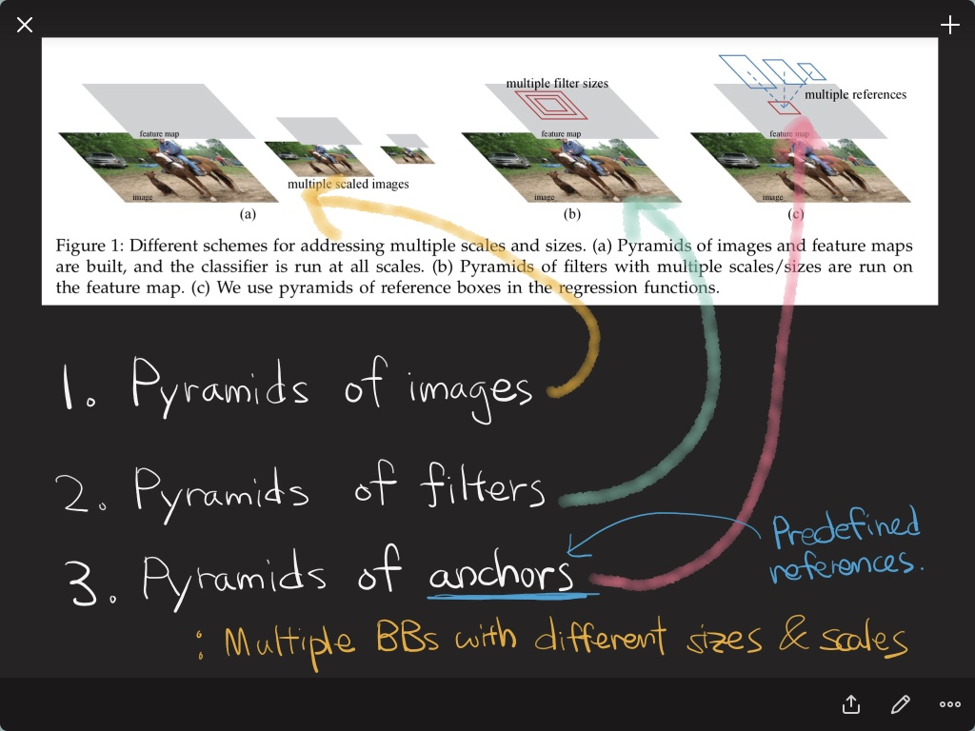

Slide 47
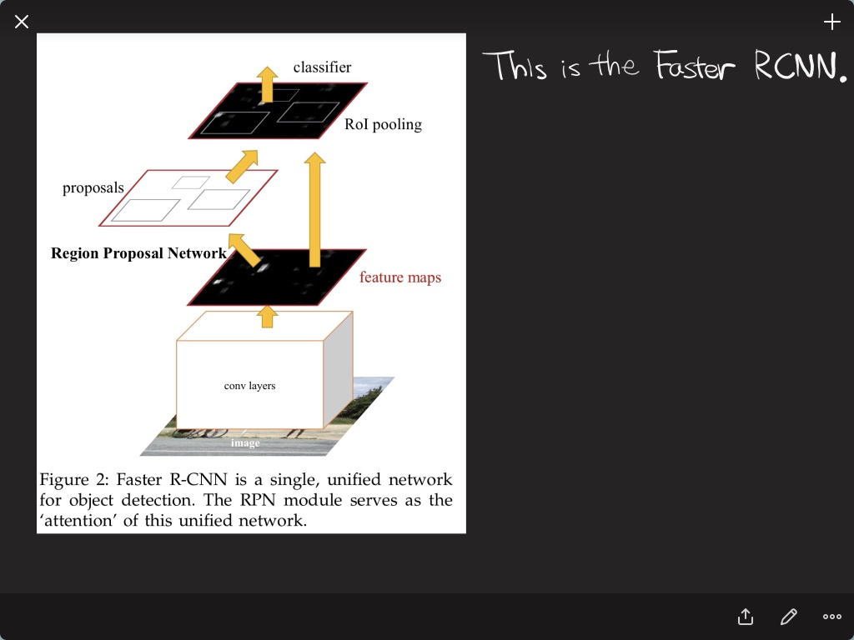

Slide 48
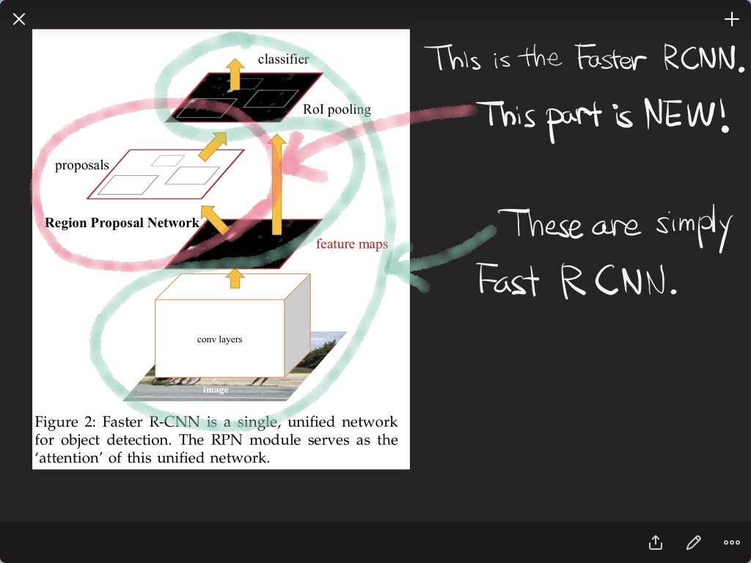

Slide 49
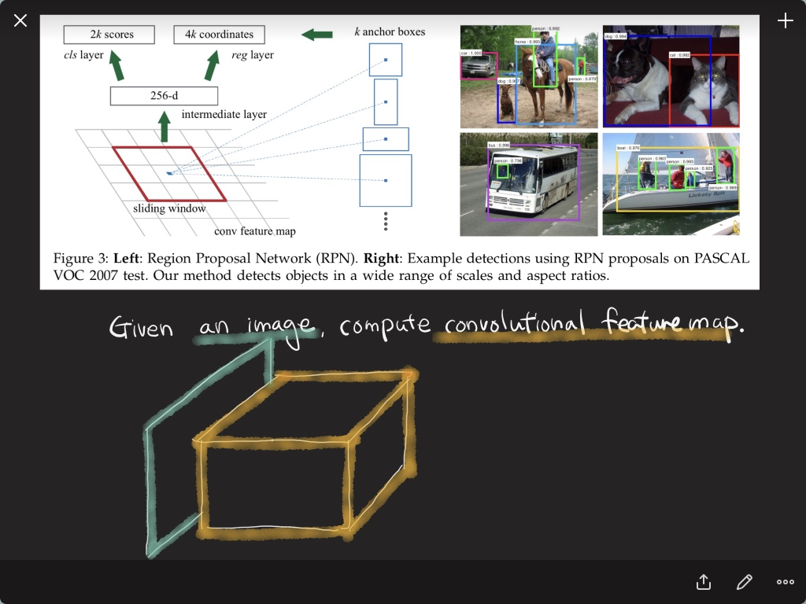

Slide 50
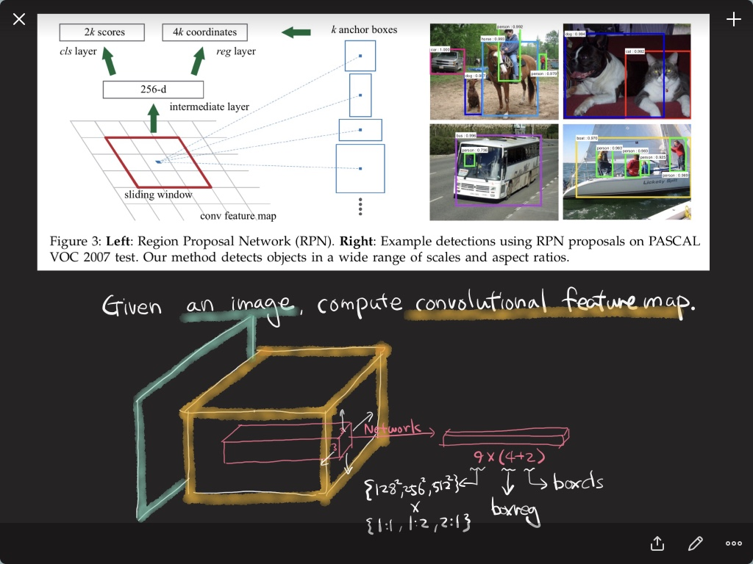

Slide 51
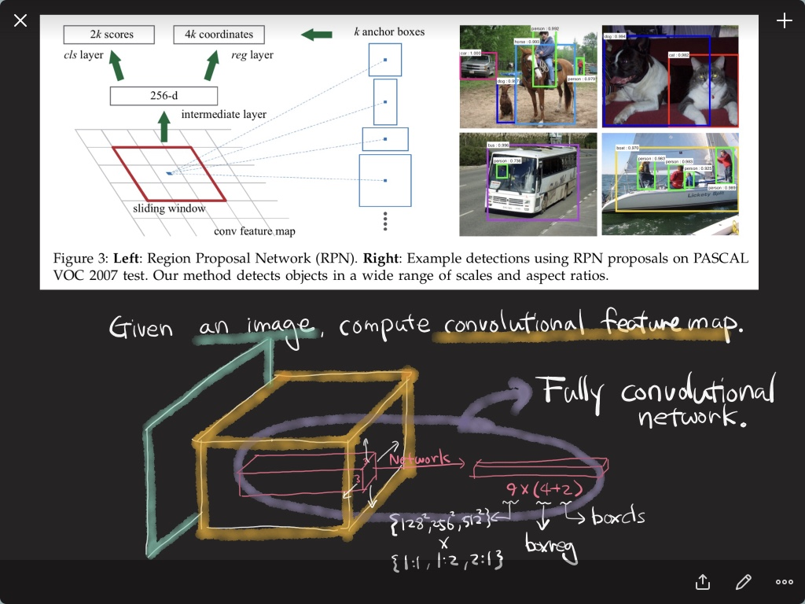

Slide 52
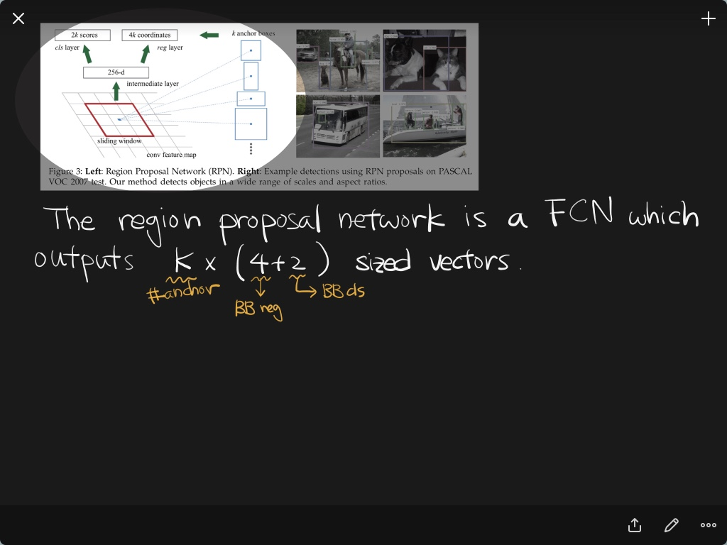

Slide 53
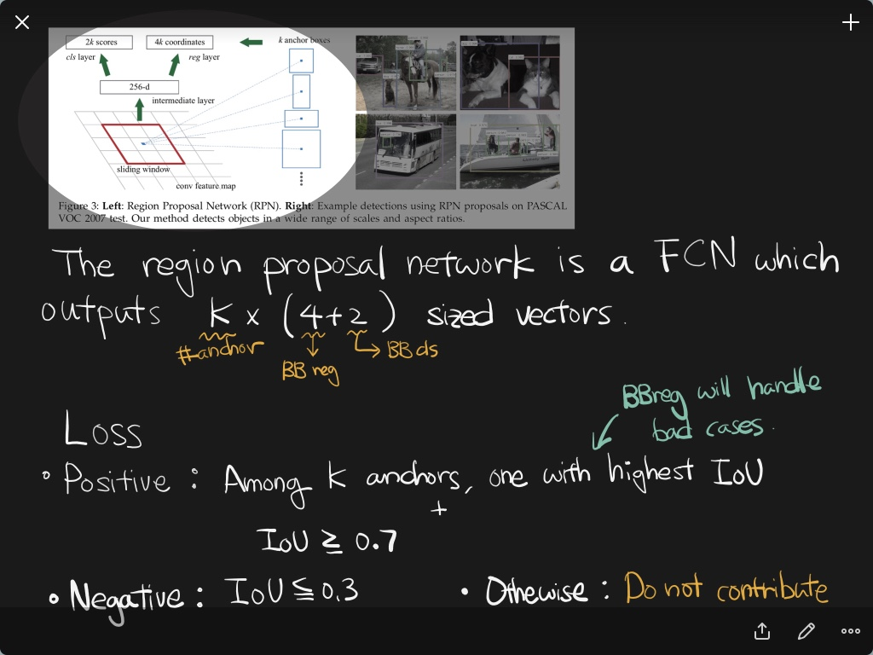

Slide 54
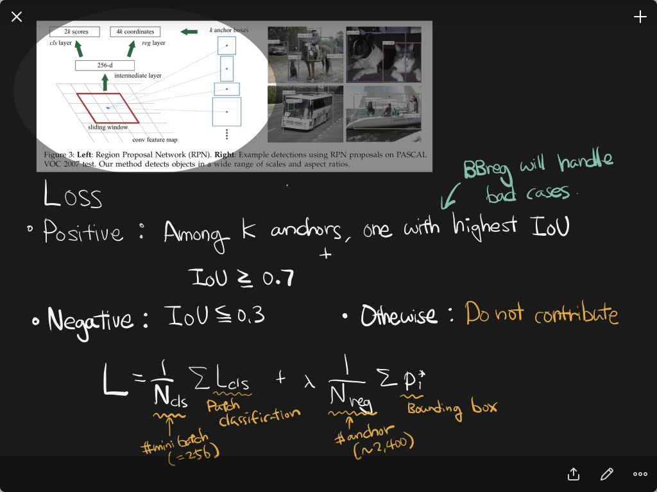

Slide 55
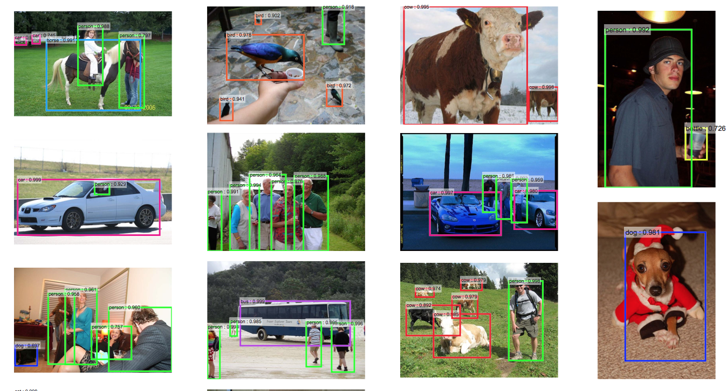
Results

Slide 56
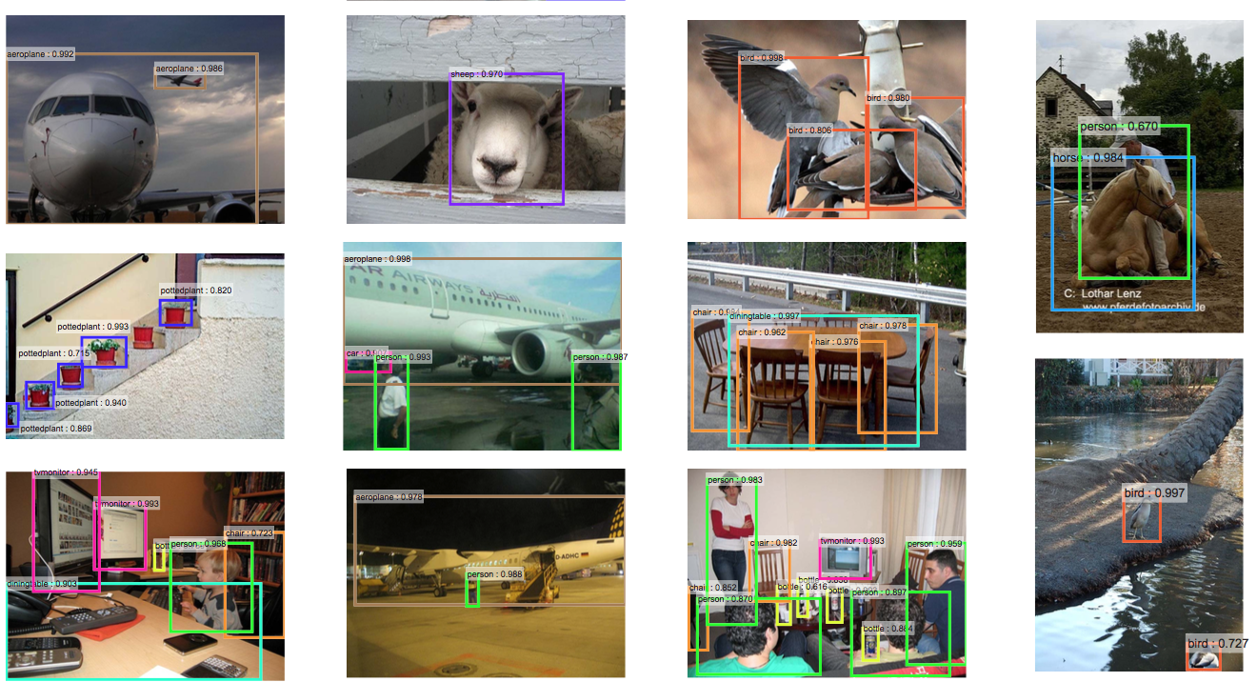
Results

Slide 57
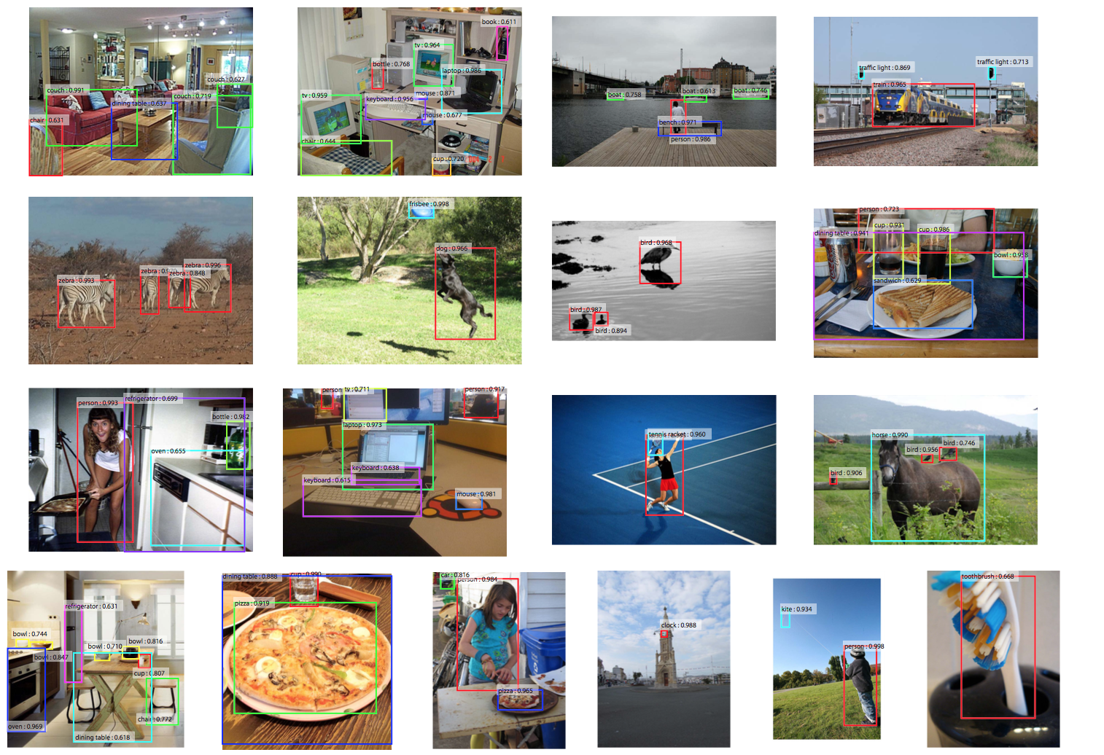
Results

Slide 58
R-CNN
Image
Regions
Resize
Convolution Features
Classify

Slide 59
SPP net
Image
Convolution Features
Regions
SPP
Classify

Slide 60


R-CNN vs. SPP net
R-CNN
SPP net

Slide 61
Fast R-CNN
Class Label
Convolution Features
RoI Pooling Layer
Confidence
Image
Class Label
Regions
RoI Pooling Layer
Confidence

Slide 62



R-CNN vs. SPP net vs. Fast R-CNN
R-CNN
SPP net
Fast R-CNN

Slide 63
Faster R-CNN
Fast R-CNN
BB Classification
Image
Fully Convolutional Features
Bounding Box Regression

Slide 64

R-CNN vs. SPP net vs. Fast R-CNN
R-CNN
SPP net
Fast R-CNN
Faster R-CNN

Slide 65

Results

Slide 66


Slide 67


Slide 68


Slide 69


Slide 70


